Slide 1
Introduction to Data Science and R
EPID 600: Data Science for Biomedical Informatics
Blanca E. Himes, Ph.D.
8/30/16

Slide 2
About the Course
Thank you for taking the course!
Please provide feedback throughout
We will use CANVAS to distribute materials
https://canvas.upenn.edu/

Slide 3
Course Outline
Module 1
Learn R and basics of data science
Module 2
Learn about biomedical informatics data types
Apply skills learned in Module 1 to a wide variety of problems
Final Project
Your chance to ask/answer a question of interest
Answer this question learning skills developed throughout the course

Slide 4

What is Data Science?
https://hbr.org/2012/10/data-scientist-the-sexiest-job-of-the-21st-century/
Notes:
https://hbr.org/2012/10/data-scientist-the-sexiest-job-of-the-21st-century/
http://www.forbes.com/sites/gilpress/2015/04/30/the-supply-and-demand-of-data-scientists-what-the-surveys-say/
http://www.forbes.com/sites/gilpress/2013/08/19/data-science-whats-the-half-life-of-a-buzzword/

Slide 5
What is Data Science?
A data scientist is a high-ranking professional with the training and curiosity to make discoveries in the world of big data.
Term coined in 2008 by D.J. Patil and Jeff Hammerbacher, then the respective leads of data and analytics efforts at LinkedIn and Facebook.
Companies are wrestling with information that comes in varieties and volumes never encountered before.
https://hbr.org/2012/10/data-scientist-the-sexiest-job-of-the-21st-century/
Notes:
https://hbr.org/2012/10/data-scientist-the-sexiest-job-of-the-21st-century/
http://www.forbes.com/sites/gilpress/2015/04/30/the-supply-and-demand-of-data-scientists-what-the-surveys-say/
http://www.forbes.com/sites/gilpress/2013/08/19/data-science-whats-the-half-life-of-a-buzzword/

Slide 6
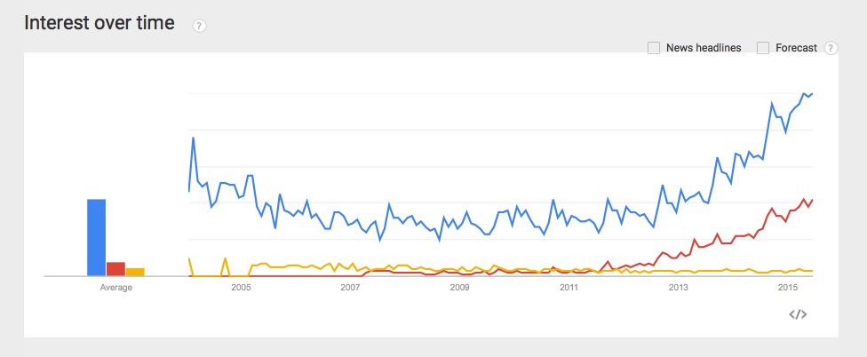
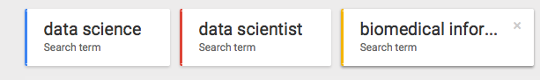

Data Science Becoming More Popular

Slide 7
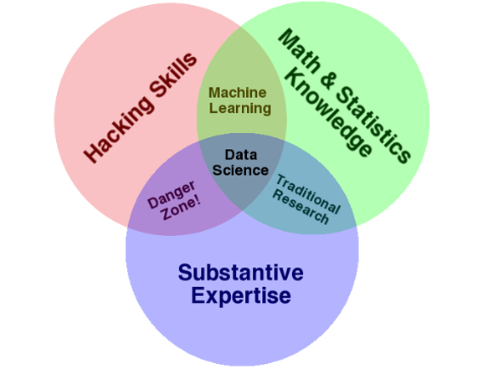
Skills Needed in Data Science
Biomedical Knowledge
Figure Data Science Skills--Source: Drew Conway
Notes:
Figure: http://www.forbes.com/sites/gilpress/2013/08/19/data-science-whats-the-half-life-of-a-buzzword/
Data Science Skills--Source: Drew Conway

Slide 8
Data Science Steps
Define question
Obtain data
Clean data
Exploratory analysis
Inferential analysis
Predictive analysis
Identify causes via further studies
Functional validation
Prospective randomized control studies

Slide 9
No Boundary Thinking
“A well-defined, real-world science problem should be based on knowledge of a variety of disciplines, but not from a specific currently-defined discipline or several disciplines. We need to define the science problem… without boundaries of disciplines.”
Data scientists should participate in experimental design
Data scientists can drive scientific questions
Interdisciplinary teams are well positioned to ask and answer novel scientific questions
http://www.biodatamining.org/content/6/1/19

Slide 10
Introduction to the software we will use

Slide 11
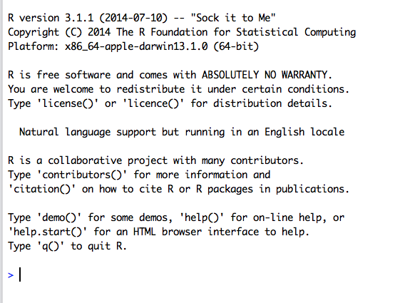
What is R?
R is a free and open source statistical programming language
Invented by Robert Gentleman and John Chambers at University of Auckland in 1993
Based on S
http://www.r-project.org

Slide 12



Features of R
Can use both interactively and for tool development
Large and active community of users and developers
Advanced graphics capabilities
Reports can be created easily
C/C++
Ease of use
Ability to write efficient/customizable code

Slide 13
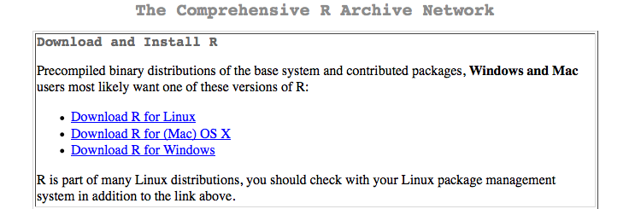
Comprehensive R Archive Network (CRAN)
Main repository of R and “base” packages that get installed by default
Contains >4000 other packages from users/developers around the world
Documentation and tutorials for various needs
http://cran.r- project.org

Slide 14
Limitations of R
It takes time to learn
Some complain it isn’t user-friendly enough, others that it isn’t a “real” programming language
Not ideal for basic manipulation of text files
Parallel computing

Slide 15
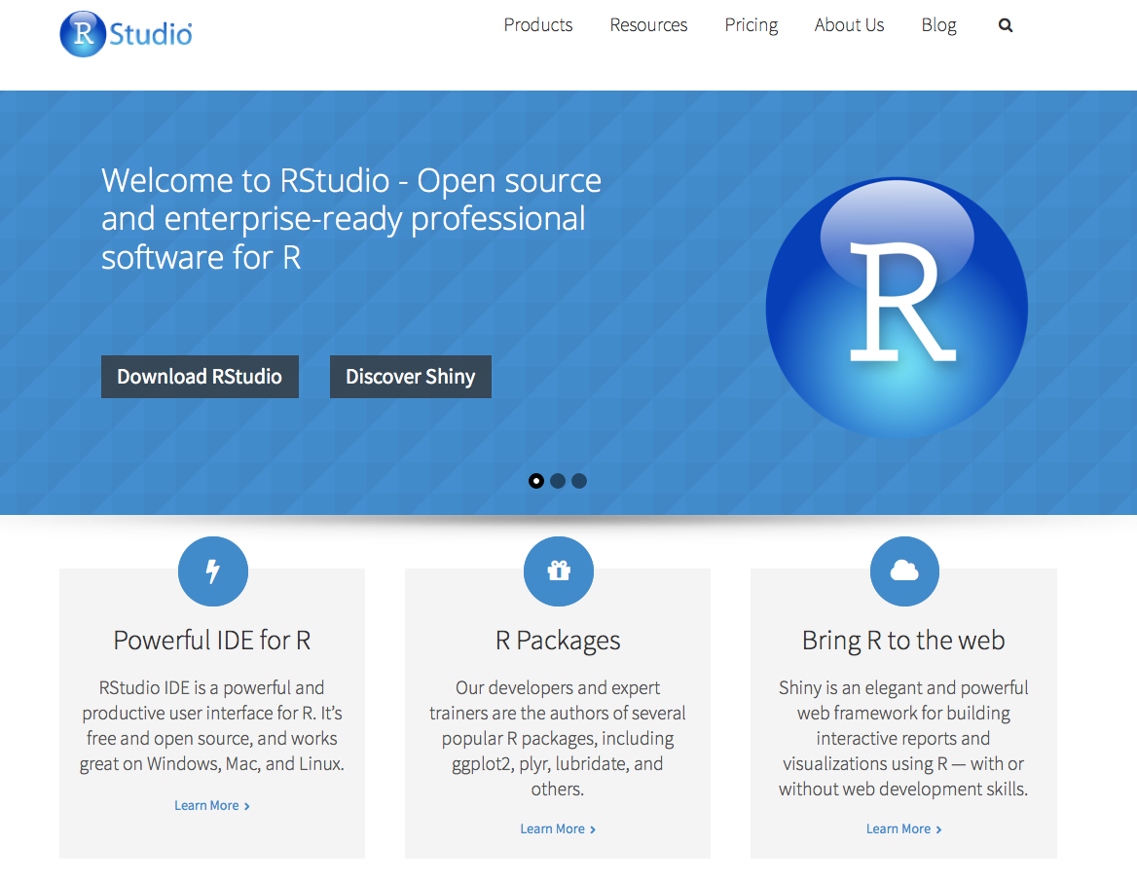
R Studio
www.rstudio.com

Slide 16
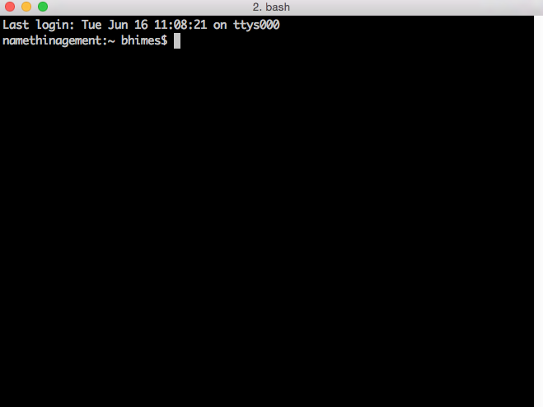
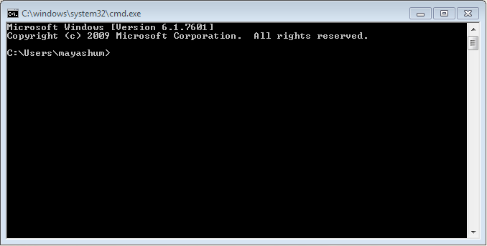
Command Line
To handle very large datasets, using command line-based functions and programs is necessary
Command Prompt or Powershell in Windows
iTerm, terminal on Mac

Slide 17
Unix
Operating systems that allow for multiple users and high-performance computing environments
Directory structure
Like a tree, path to current directory, “root” “home”
Basic commands
cd, mkdir, mv, pwd, ls (ls –a and hidden files), man, clear, cp, rm (rm –rf and rmdir), date, echo, touch
Commands look like:
command flags (preceded by dashes) arguments
To view/edit files:
less, more

Slide 18
Text Editors
Powerful programs used to view and modify files, including computer code
Look simple
Can do many operations on plain text
Popular editors: vi/vim, emacs
A plethora of free and paid ones are available
For course: we will use the one available with RStudio

Slide 19

Git
Version control system
Allows tracking/restoring of files over time
Efficient way to keep annotation and track errors
Great for projects with multiple contributors
Popular open source version control system
Command line based
Files related to a project are stored on a local computer “repository”
https://git-scm.com/

Slide 20
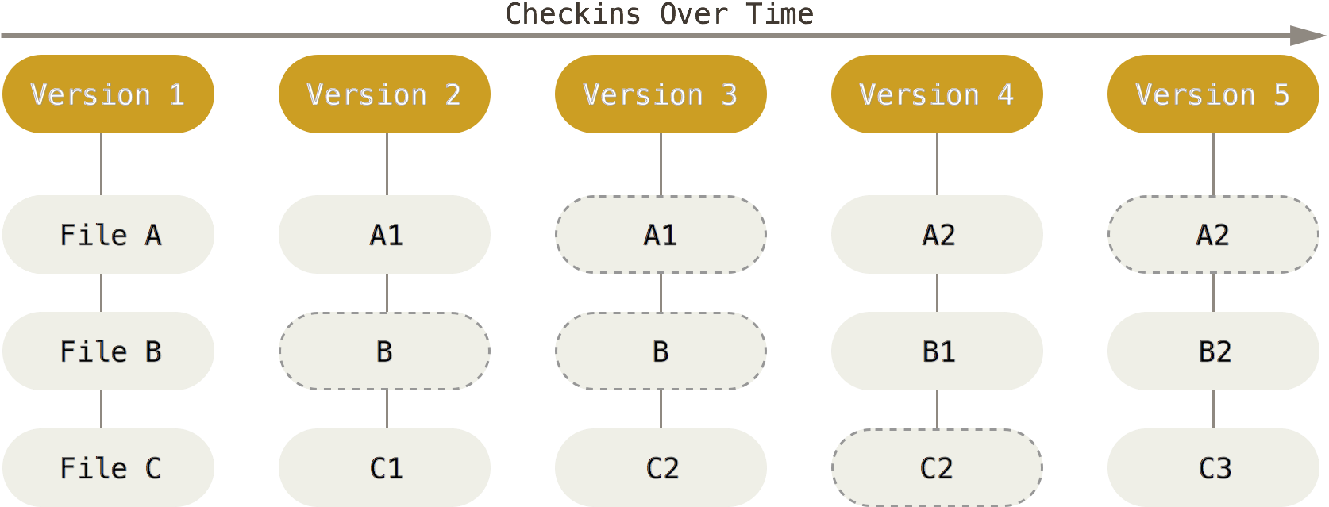
Version Control with git
https://git-scm.com/book/en/v2/Getting-Started-Git-Basics

Slide 21
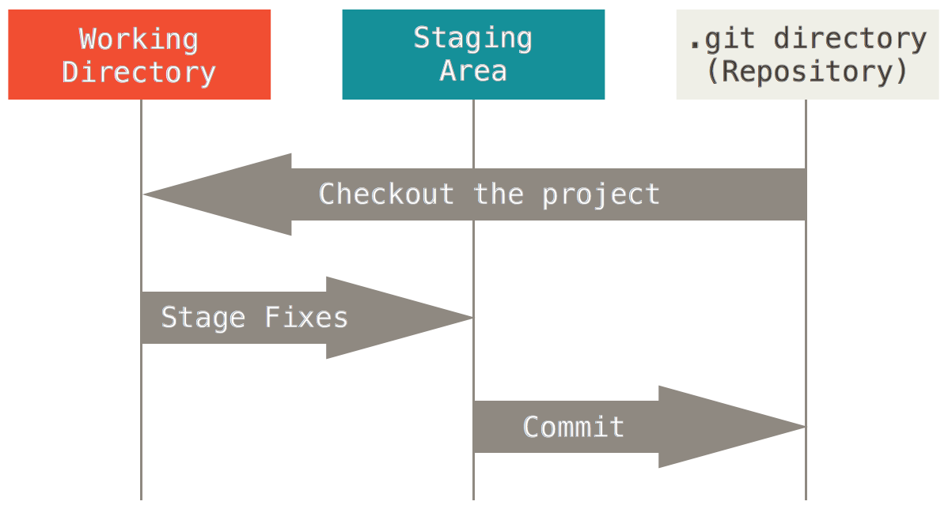
Version Control with git
https://git-scm.com/book/en/v2/Getting-Started-Git-Basics

Slide 22
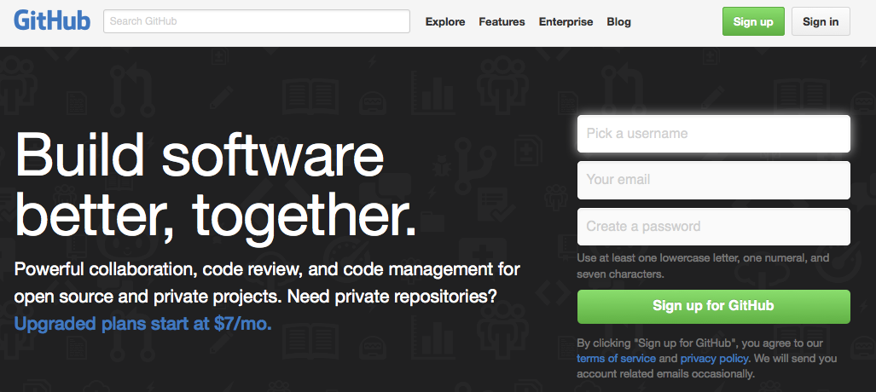
Github
Web-based platform that hosts projects using git for version control
Can share code with others and access others’ code
Some R packages available here
https://github.com/

Slide 23
Repository
A collection of files that are part of a project
README – document describing the repository and its contents
LICENCE – defines permissions/restrictions of files and code in the repository
CITATION – how to cite the repository
Code can be in any language or a combination of many
Not all repositories contain code

Slide 24

How GitHub Works
Users “push” and “pull” local repositories to/from those on web
Each user has his/her own GitHub page
Github commands run on shell or can use a graphical interface
Even if you are not an advanced programmer, you can use GitHub as a “back-up” and place for collaboration

Slide 25
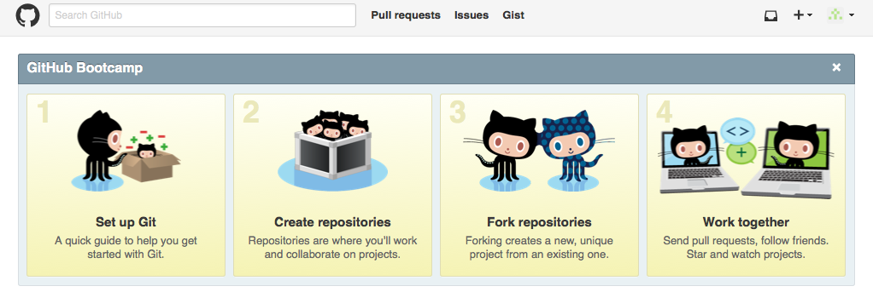
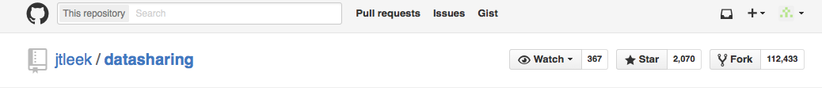
GitHub Repositories (Repos)
Create your own
Copy, or “fork”, another user’s repository

Slide 26
Getting Help
Part of being a data scientist is to be able to seek answers on your own
Put some effort into it
Don’t be afraid of data/errors
Admission of not knowing something is OK
Most questions you have have already been answered

Slide 27
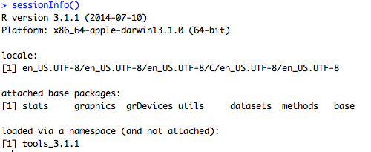
Describing a Problem
Give details of question, but be brief!
Environment
Code you tried
Error message
Actual vs. expected output
Include sessionInfo() if question related to R

Slide 28

Where to Get Help

Slide 29


Where Else to Get Help
Biostars
R-help and R-devel mailing lists
Help within R:
?rnorm
help.search(“rnorm”)
args(“rnorm”)
http://stackoverflow.com
https://www.biostars.org
http://www.r-project.org/posting-guide.html

Slide 30
Getting Help While Taking the Course
Colleagues
During scheduled class sessions
Schedule office hours
Email us questions
Blanca Himes (bhimes@upenn.edu)
Ryan Urbanowicz (ryanurb@upenn.edu)

Slide 31
Course Assignments

Slide 32
Assignments
Module 1:
Three assignments to turn in
Practice R and work toward final project
Module 2:
Three assignments to turn in
Keep practicing R on applied biomedical topics
Make progress toward, and complete, final project
40% of grade
Assignment 1:
In CANVAS under “Assignments” module.
Due on 9/6/16

Slide 33
PRACTICUM 1
Go to course CANVAS page (https://canvas.upenn.edu)
Under “Files” download “1_introduction.html”

